Slide 1
Assignment 7
Submitted by : GROUP 5
Ankitkumar Patel
Gurvinder Singh
Krutika Fanse
Submitted to
Prof. Mike Aleshams

Slide 2
Contents
Introduction
Working with EasyEDA
Designing Blocks
Schematic Design
References

Slide 3
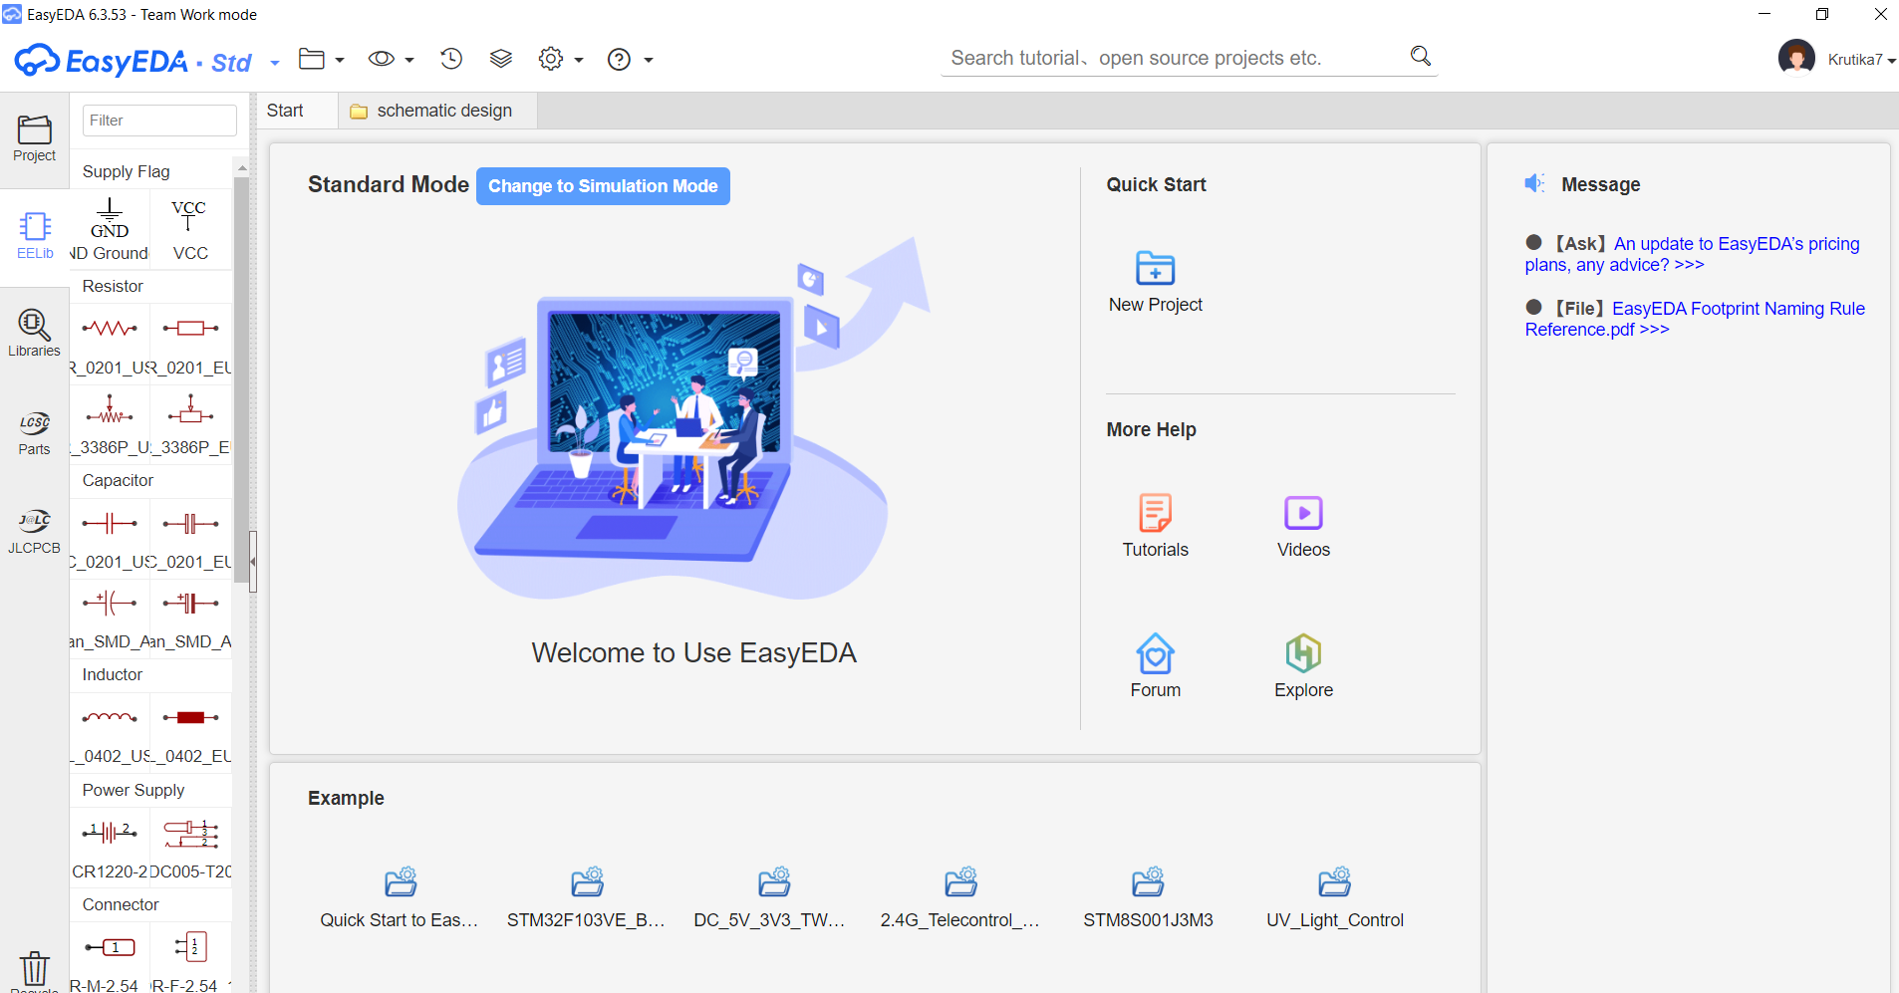
Introduction
EasyEDA is an open source web based Electronic Design Automation tool.
It has a user friendly interface with an enormous built-in libraries.
It provides real time team cooperation and numerous open source projects.
Some of the main features are Schematic Capture, PCB layout, Library Management and Import.

Slide 4
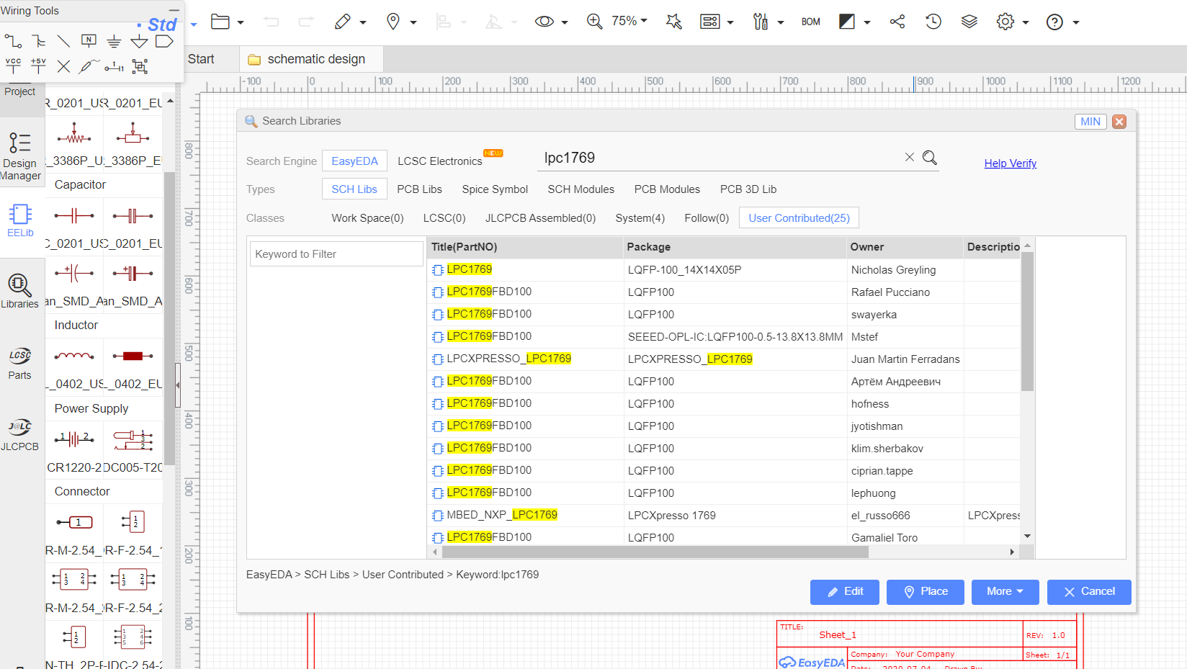
Working with EasyEDA
The User interface is simpler in comparison to other softwares.
The libraries of the tool provides 700,000+ components.
For the designing of the schematic, user has to just drag and drop the components.
Library also has User Contributed components that are modified according to user requirement.

Slide 5
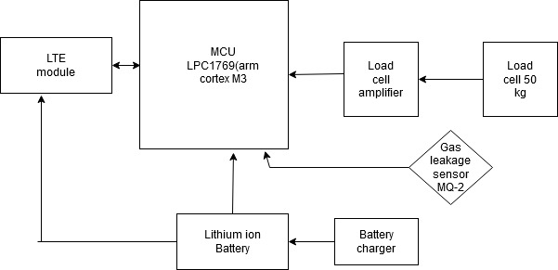
Block Diagram
The block diagram of the proposed IoT based smart weigh scale and tank monitor.

Slide 6
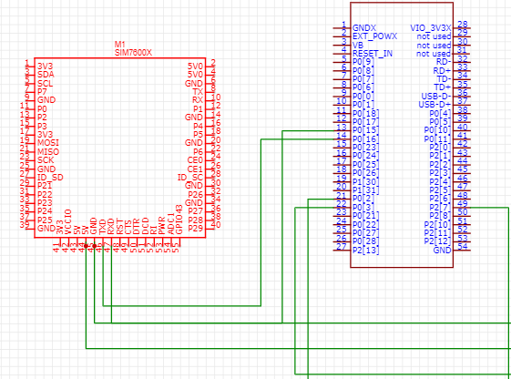
Designing Blocks
Based on the proposed block diagram, the designing initiates as,
SIM7600X is the variant of LTE Module which connected to the LPC1769 with the help jumper wires.
LTE pin 46 (TXD) to pin 14(P016)
LTE pin 47 (RXD) to pin 13(P015)
LTE (P015 and 16 are GPIO pins)

Slide 7
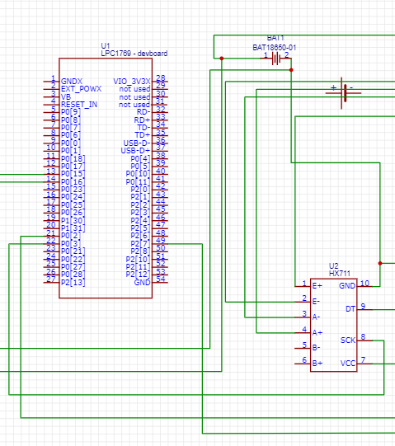
The LPC1769 is connected to the Loadcell amplifier HX711
LPC1769 pin 21 (GPIO) to HX711 pin 9(DT)
LPC 1769 pin 22 (GPIO) to HX711 pin 8(SCK)

Slide 8
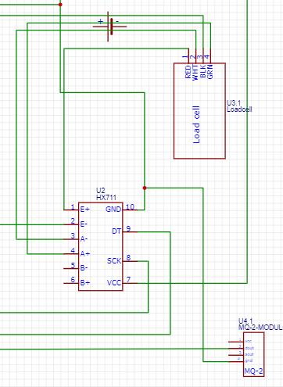

The Loadcell is connected to HX711
Loadcell pin1(RED) Hx711 pin1( E+)
Loadcell pin3(BLK) HX711 pin 2(E-)
Loadcell pin2 (WHT) HX711 pin3( A-)
Loadcell pin4 (GRN) HX711 pin4( A+)
The Loadcell amplifier has common ground with the batter and the MQ-2 sensor.
The MQ-2 sensor is connected to loadcell amplifier
HX711 pin7 (VCC) MQ-2 pin1 (VCC)

Slide 9
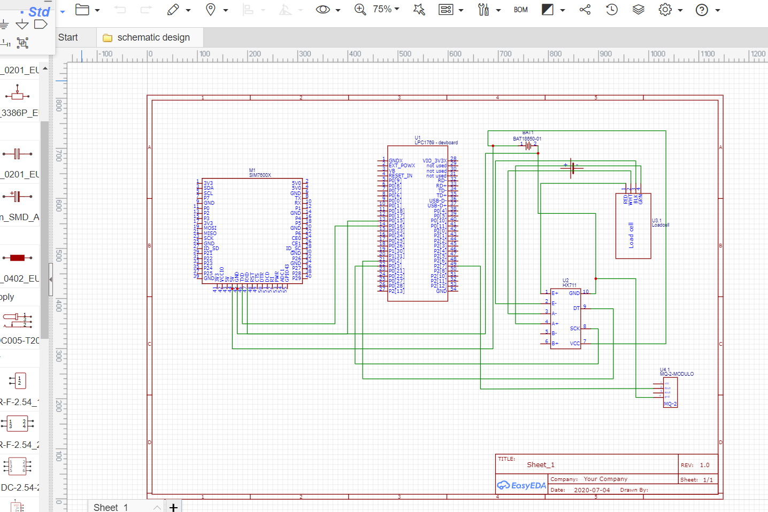
Schematic Diagram

Slide 10
References
Introducing: EasyEDA 2 KiCad by Uri Shaked , Modified on November 15, 2019
https://medium.com/@urish/introducing-easyeda-2-kicad-37489da1dfa7
Load Cell Amplifier HX711 Breakout Hookup Guide by Sarah Al-Multaq and Alex the Giant, Modified on January 12, 2019
https://learn.sparkfun.com/tutorials/load-cell-amplifier-hx711-breakout-hookup-guide/discuss
Schematic Design Software by Gerry Chen, Modified on June 12, 2016
https://easyeda.com/GerryChen/Schematic_Design_Software-GuoGAR9rl

